Slide 1




NASA Space Technology Research Fellowship (NSTRF) Update
Timothy Hackett
Systems Design Laboratory
Penn State University
1/5/2016

Slide 2
What have I been doing?
Submitted required NSTRF-related documentation
FPGA Fixed-Point Linear Algebra Library
In-person work session with Paulo
Generated questions list for this trip

Slide 3
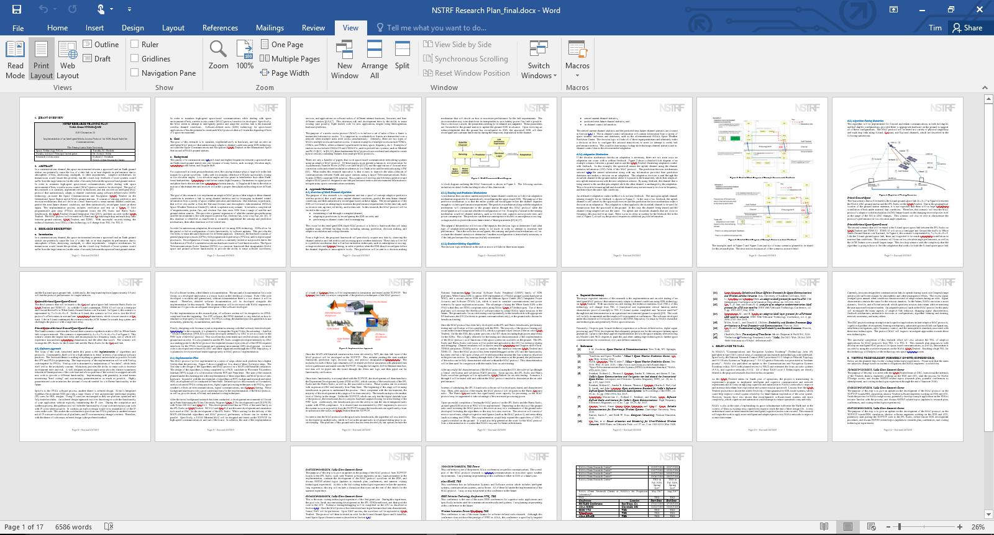
NSTRF Research Plan, Progress Report #1

Slide 4
Linear Algebra Library
Fixed-Point Matrix Adder (parallel/sequential operation)
Fixed-Point Vector Inner Product (parallel/sequential operation)
Fixed-Point Matrix Multiplier (parallel/sequential operation)
Fixed-Point Matrix Inversion (parallel/sequential operation)

Slide 5
Matrix Adder

Slide 6
Matrix Adder

Slide 7
Vector Inner Product

Slide 8
Vector Inner Product

Slide 9
Matrix Multiplier

Slide 10
Matrix Multiplier

Slide 11
December Work Session with Paulo
System level discussions
Discussion to IMM Rain-Fade paper
Updated timelines
Updated scenarios
Project management discussions
Identified conferences/journals to present/publish
Compiled a questions list for GRC

Slide 12
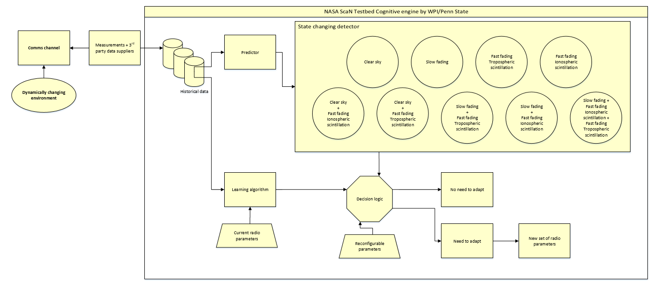
Full System Block Diagram

Slide 13
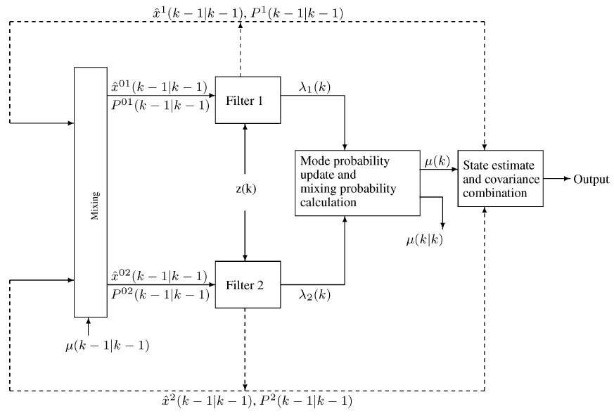
IMM Kalman Filter Predictor

Slide 14
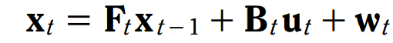

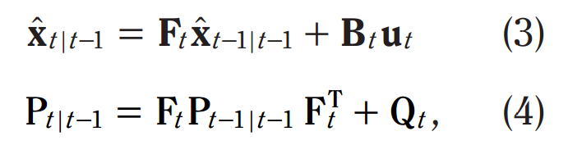
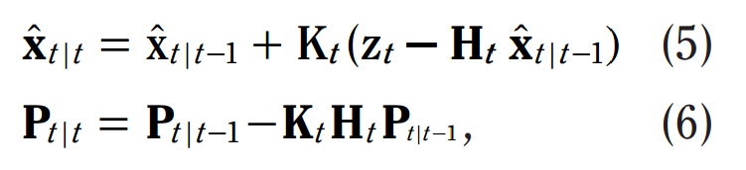
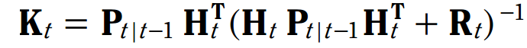
IMM Kalman Filter Predictor
State Equation
Measurement Equation
State Prediction Equation
Covariance Prediction Equation
State Measurement Update Equation
Covariance Measurement Update Equation
Kalman Gain Equation

Slide 15
Updated Timeline
* Conference paper
Δ Journal Article
Paulo
Jan 1
Feb 1
Mar 1
Apr 1
May 15
June 15
*
Δ
*
*
IMM Complete
IMM Complete
Learning
Algorithm
Complete
Decision Algorithm Complete
MAC Header Complete
3rd Party Databases Complete
Jan 15
Mar 1
Apr 15
May 1
*
Δ
Linear Algebra Library Complete
IMM
Complete
Learning Algorithm Complete
Decision Algorithm Complete
Tim

Slide 16
Updated Scenarios

Slide 17
Updated Scenarios

Slide 18
Updated Scenarios

Slide 19
Updated Scenarios

Slide 20
Questions List
Update on available JPL/Harris Radio waveforms?
Everything on Excel sheet, DVB-S2 waveform, and Reconfigurable Bandwidth-Efficient Transmit Waveform for High-Rate Telemetry (STRS repo)
How often can we poll the received power level?
No limit, 10 Hz has been done on Harris
Is it possible to switch between Ka-band and S-band for a frequency-agile scheme?
Yes, we would need to coordinate TDRS access opportunities so we have both frequency bands open at the same time.
What is the FPGA utilization on the JPL radio with the DVB-S2 transmitter waveform enabled?
~50% of one slice
Floating point vs. fixed point on FPGA?
Ask Mike about JPL floating point, Harris has floating point
Can we use SCaN Testbed in a bent-pipe configuration?
GRC <S-band> JPL Radio <SpaceWire through Avionics> Harris Radio <Ka-band> TDRS <Ku-band> WSC
Yes, we will need a low data rate waveform (only waveform that is on both is 3 Mbps) which would be pushing the SpaceWire software router (which can handle about 20 Mbps).
How much flexibility do we have on changing the power level of the transmitters on Testbed? (I remember some drive-level issues)
Yes, we can change the power level dynamically – there isn’t a waveform that has it, but yes possible.
What closed loop pointing control system does the Ka-band/S-band antennas use? (it had been asked to be able to detect pointing errors with the intelligent algorithm).
for legacy waveforms, we can do closed loop on TDRS. For DVB-S2 (and other newer waveforms), SCaN->TDRS is closed loop but TDRS->SCaN is open-loop. We can’t change what TDRS is pointing, but we can at least detect that there’s a pointing issue.
Code release on GitHub – what can be shared, what cannot?
we have to go through a process at Glenn for flight code.
When/How should I transition to the breadboards?

